Slide 1

COVID-19 Tweets Analysis and Prediction
Harsh Sharma 202410116100084
Harsh Maheshwari 202410116100083

Slide 2
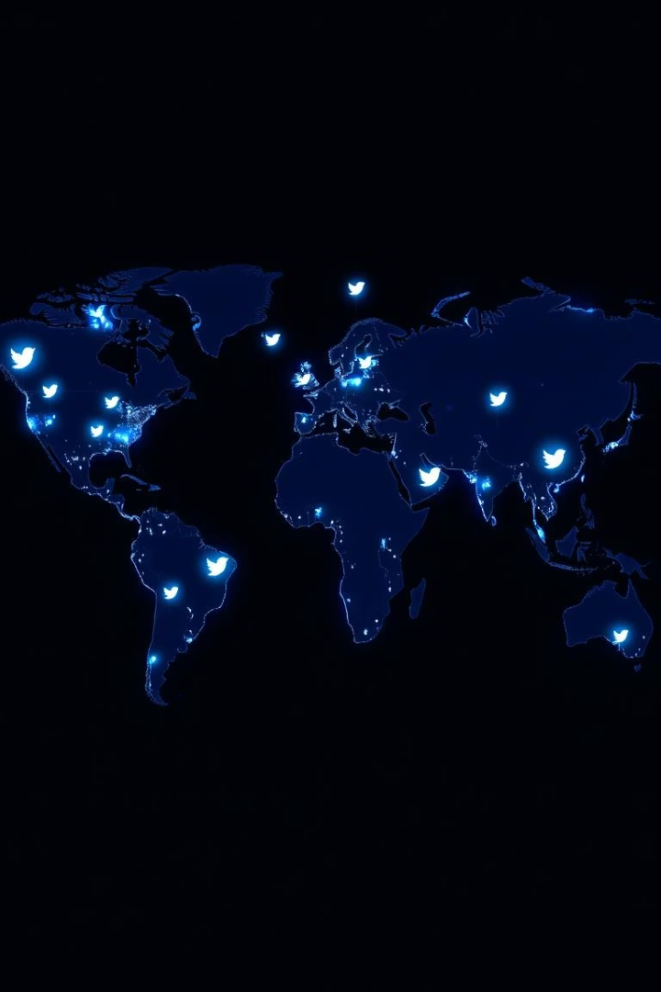
Introduction to Analysis
Context
Purpose
Analyzing public sentiment on COVID-19 using social media data.
To understand sentiment trends and predict future public reactions.
Scope
Focuses on tweets collected during the pandemic for real-time insights.

Slide 3




Technology Stack
Natural Language Processing
Transformers
Time Series Forecasting
Using pretrained BERT model for multilingual sentiment analysis.
Predicting sentiment trends over time using Facebook Prophet tool.
Cleaning and analyzing tweet text, extracting sentiment scores.

Slide 4
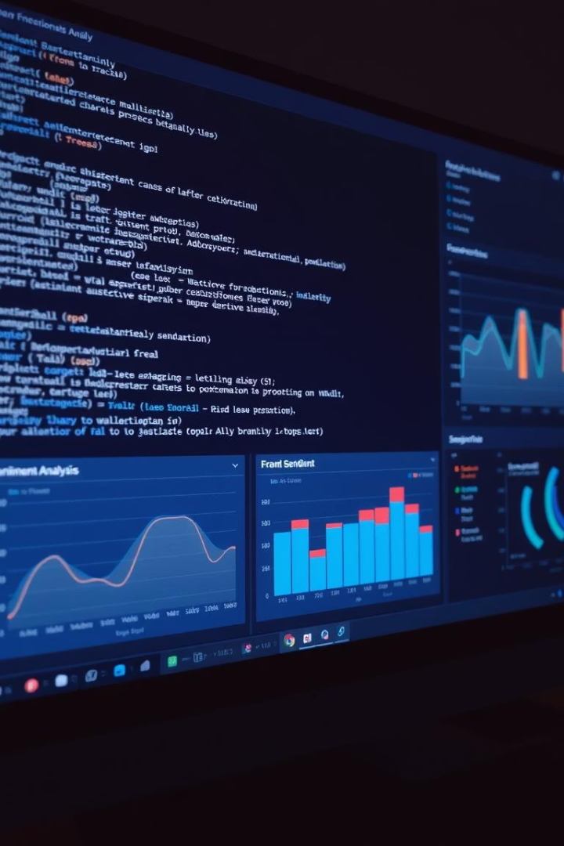
Code Features & Tools
Feature
Present
Details
NLP
✅ Yes
Tweet cleaning and sentiment analysis performed
Transformers
✅ Yes
Used pretrained BERT model nlptown/bert-base-multilingual-uncased-sentiment
Time Series
✅ Yes
Forecast sentiment counts by date with Facebook Prophet
COVID-19 Tweets
✅ Yes
Analysis based on Corona_NLP_test.csv dataset
Prediction
✅ Yes
Forecast future positive tweet trends using Prophet

Slide 5

Detailed Analysis Description
Data Preparation
Sentiment Classification
Trend Aggregation
Tweets cleaned to remove noise and irrelevant characters.
Each tweet classified as positive, negative, or neutral.
Sentiment counts grouped by date for time-series modeling.

Slide 6

Future Scope
Real-time Prediction
Improve Model Accuracy
Implement streaming data analysis for live sentiment updates.
Expand Data Sources
Use advanced transformers and ensemble methods for better predictions.
Include other social media platforms and news feeds.

Slide 7

Conclusion
The project combines NLP, transformers, and time series forecasting.
Predictions help understand future public sentiment trends on COVID-19.
This approach offers valuable insights for public health decision-making.

Slide 8
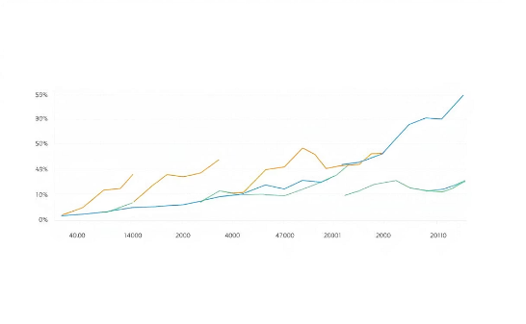
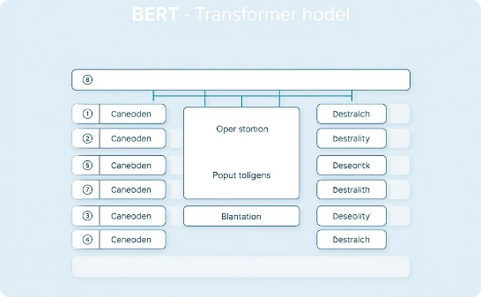
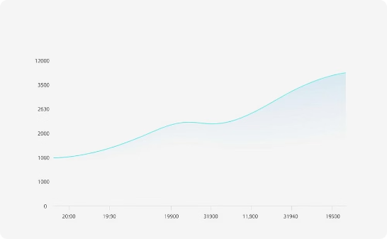
Related Images
Sentiment Over Time
Transformer Model
Forecasting Trends
Shows how positive and negative tweets fluctuate during the pandemic.
Pretrained BERT model used for sentiment analysis on tweets.
Prophet model predicts future sentiment trends from historical data.

